Slide 1
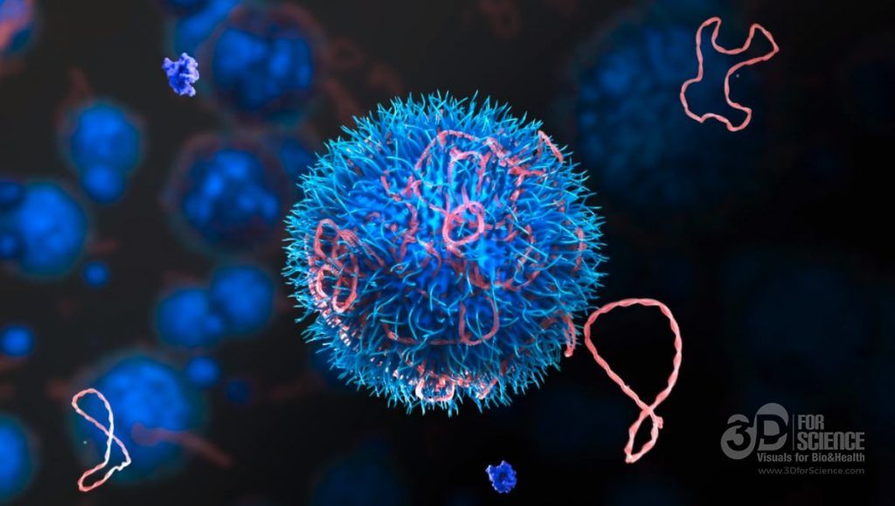

Mechanisms of Action(MoA) Prediction
Phase II
Xinbo Xia
Haoyu Guo
Rocha Zhou
https://github.com/guohaoyu110/EE542_final
Notes:
Slides can vary as per your presentation, but header and footer should be consistent

Slide 2
Project Schedule
By Nov 16 : Finish data processing (prepare data for training)
Nov 16 - Nov 23 : Deploy machine learning algorithm
Nov 23 - Nov 30: Try more deep learning algorithms and do transfer learning
Nov 30 - Dec 9: Model assembling and integration, submit the task and write report

Slide 3
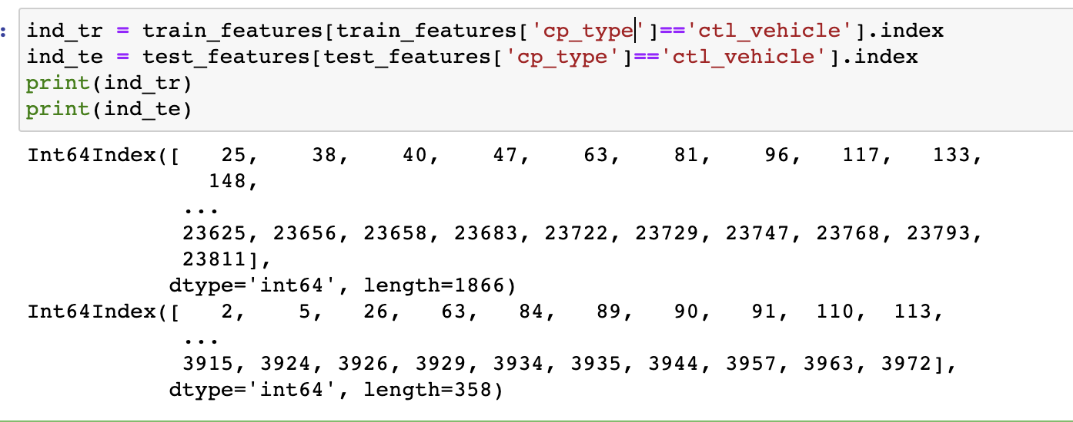
Preprocessing and feature engineering
The control group is defined as the group in an experiment or study that does not have the desired effect or MoAs here; which means the target labels are zero for them. I will drop the data for this group, and we will later set all predictions of this group to zero.
We will keep track of the control group (ctl_vehicle) indexes. I dropped cp_type column and mapped the values of time and dose features. I performed some feature engineering based on the insights I got from the kaggle notebook. I also add methods of Rankgauss and PCA for this.

Slide 4
RankGauss
How RankGauss work?
RankGauss is a popular method for feature extraction in kaggle competitions, akin to standardization. This method comes from Michael Jahrer, who is a kaggle grandmaster.
I use RankGauss to normalize. It’s based on rank transformation. First step is to assign a linspace to the sorted features from 0...1, then apply the inverse of error function to shape them like gaussians, then I subtract the mean. And this works usually much better than standard mean/std scaler or min/max.
Notes:
http://fastml.com/preparing-continuous-features-for-neural-networks-with-rankgauss/
First, let me explain what is the rankgauss method

Slide 5
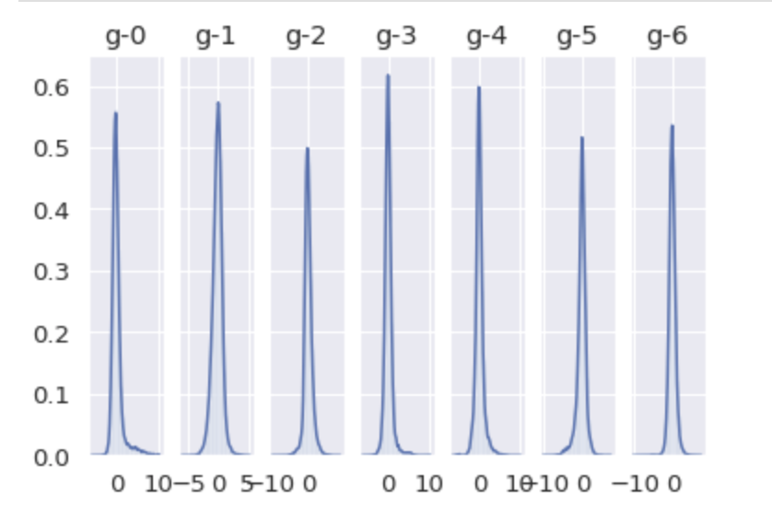
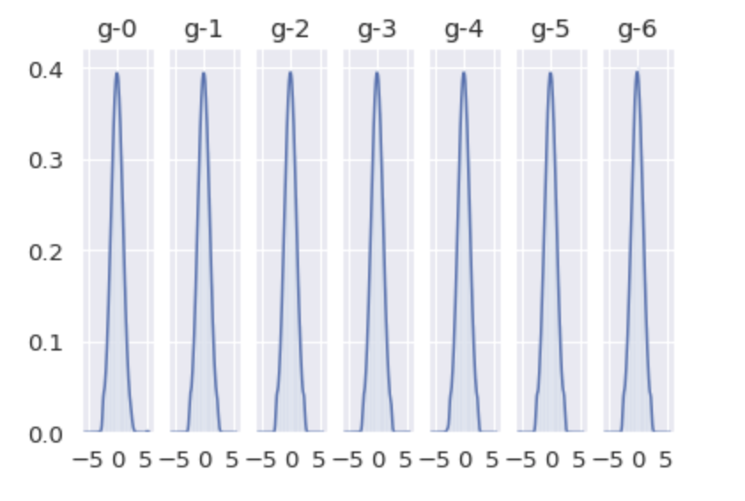
RankGauss
Before RankGauss After RankGauss
Notes:
It appears that we were able to transform the distribution of each data to resemble a normal distribution, as intended. So, let’s enter the data into the benchmarking method to see the improvement.

Slide 6
Why use PCA and K-means?
In a nutshell, I will be using a Principal Component Analysis (PCA) based approach to analysing the dataset and then implementing some K-means clustering to provide visualisations of any related clusters I find in the dataset.
A very high-level description of PCA is that it serves as a dimensionality reduction method on the features of our original dataset by projecting these features onto a lower dimension. Therefore if our original dataset contains 72 columns ( i.e features) and we manage to reduce these 72 columns down to 9 columns image the gains in time and processing speeds! However the question is how do we get the new data out of the PCA-reduced 9 columns? Via a clustering method!! In this case, I will use K-Means - more to come below.

Slide 7
K-means
It is important to determine number of clusters before applying kmeans clustering algorithm. There are two methods: Silhouette Coefficient and Elbow method. So I concat test gene data and train gene data to determine number of clusters. Before applying kmeans clustering, let’s first reduce the dimension of data using PCA.

Slide 8
K-means
K-means algorithm is the most popular and yet simplest of all the clustering algorithms. Here is how it works:
Select the number of clusters k that you think is the optimal number.
Initialize 𝑘 points as "centroids" randomly within the space of our data.
Attribute each observation to its closest centroid.
Update the centroids to the center of all the attributed set of observations.
Repeat steps 3 and 4 a fixed number of times or until all of the centroids are stable (i.e. no longer change in step 4).

Slide 9
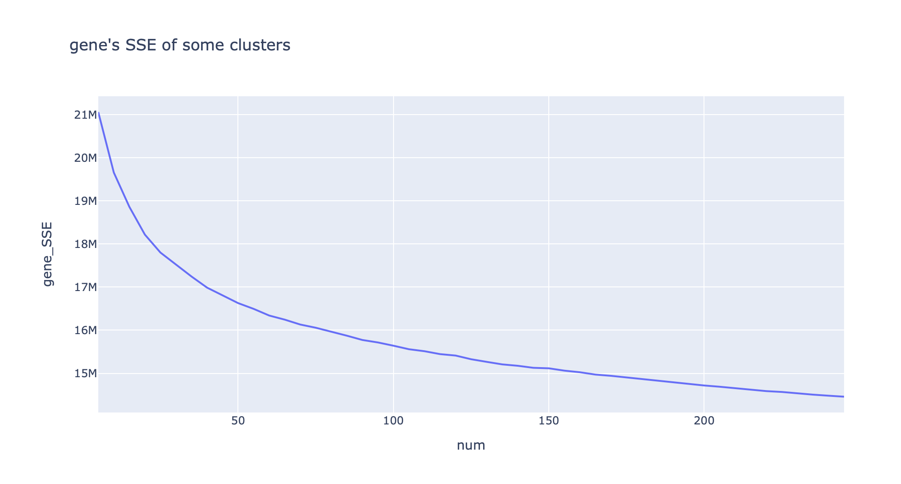
SSE of cluster
Elbow method does not provide a clear result

Slide 10
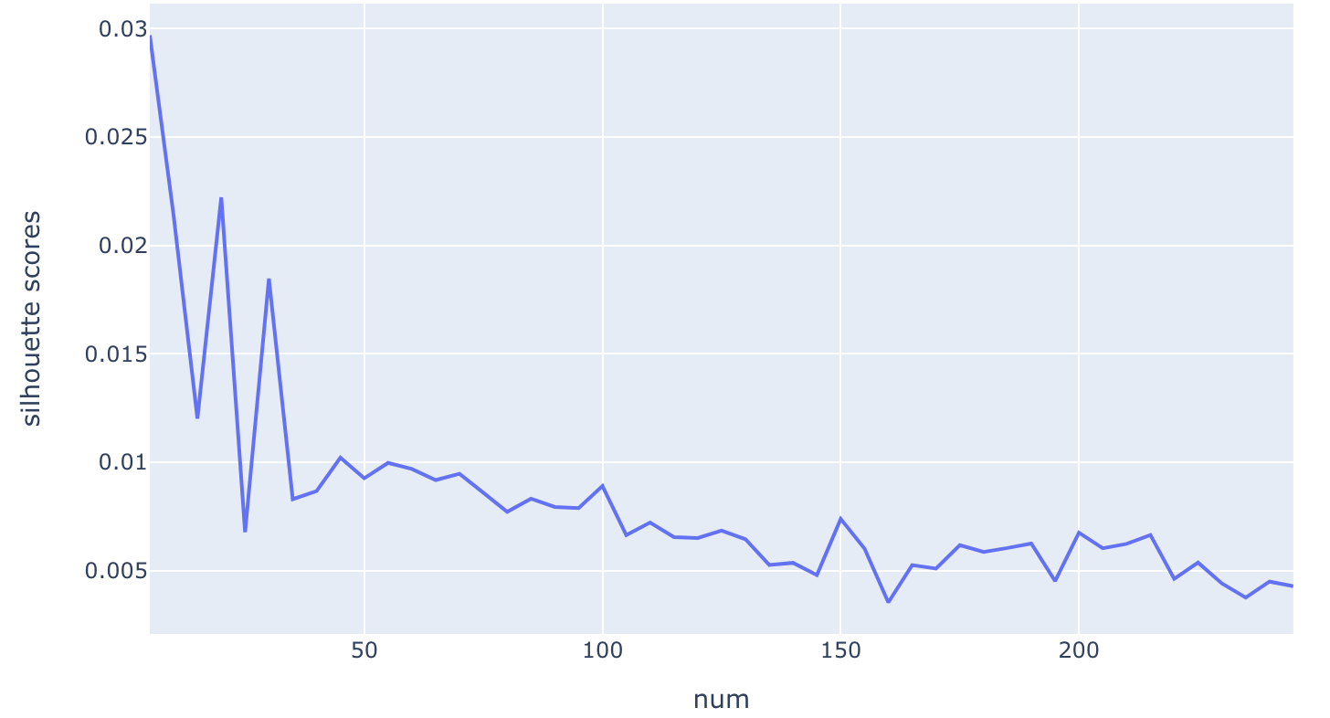
Silhouette Coefficient method
From graph on the left, 20 has the highest peaks (except 0). So, when ideal value for k is around 20.

Slide 11
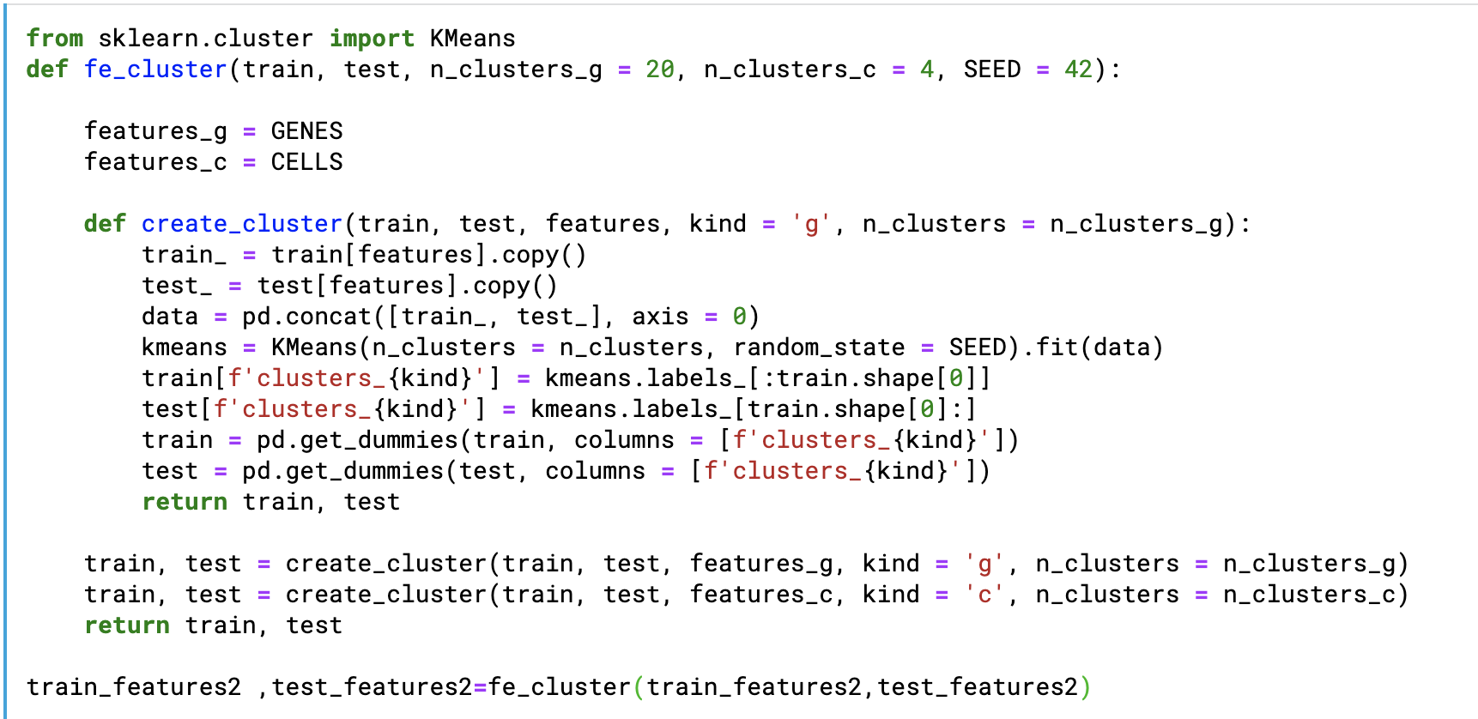
K-means
20 is ideal value for gene data and 4 is ideal value for cell data

Slide 12
Data analysis -- PCA
Principal Component Analysis is one of the easiest, most intuitive, and most frequently used methods for dimensionality reduction, projecting data onto its orthogonal feature subspace.
It is used as:
Pre-processing method before classification to reduce computational costs of the classifier.
Compression method for ease of data storage and retrieval.
Feature extraction method

Slide 13
Data analysis -- PCA
Why PCA?
Principal Component Analysis (PCA) is used to explain the variance covariance structure of a set of variables through linear combinations. It is often used as a dimensionality-reduction technique.
Does PCA lose information?
Nope. ... It is useful because it often does not lose important information when you use it to reduce dimension of your data. When you lose data it is often the higher frequency data and often that is less important.

Slide 14
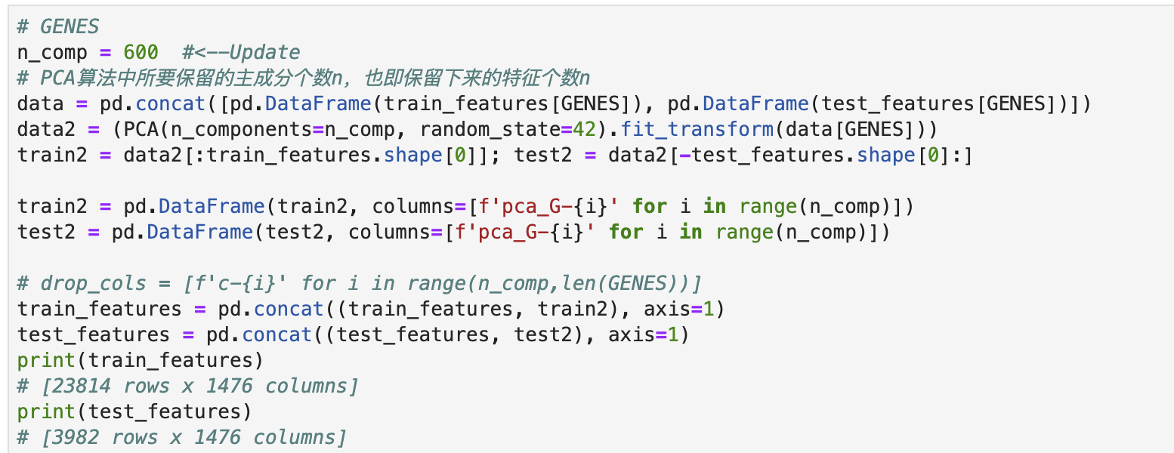
Data analysis -- PCA
N_comp: number of components to keep. If n_components is not set, all components are kept.
Random_state: pass an int value for reproducible results across multiple function calls.
Fit_transform/fit: for fit_transform (X[,y]), it fit the model with X and apply the dimensionality reduction on X; For fit, it fits the model with X.

Slide 15
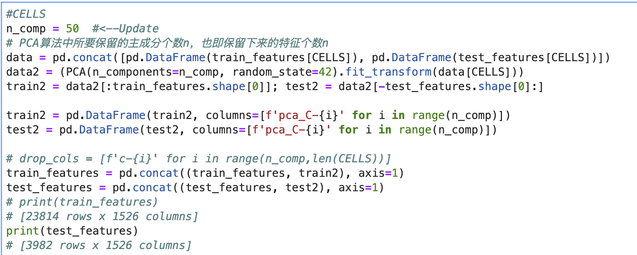
Data analysis -- PCA
In this part, regarding to CELLS, I lower the features of this to 50.
And add these features to the original one to represent.

Slide 16
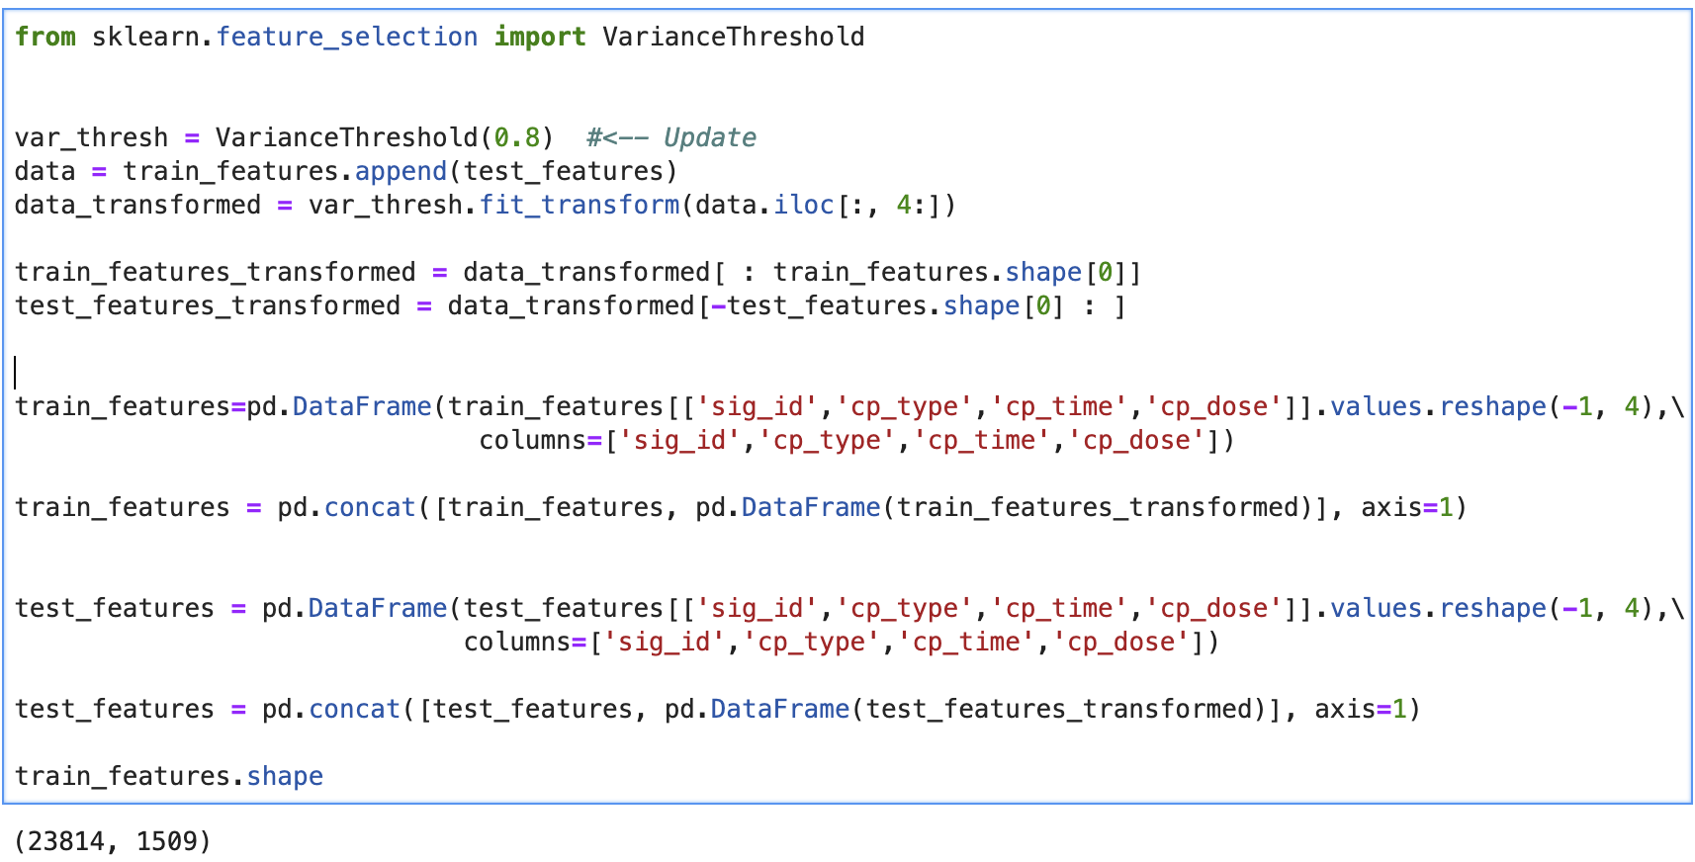
Variance threshold

Slide 17
Variance threshold
Variance threshold from sklearn is a simple baseline approach to feature selection. It removes all features which variance doesn't meet some threshold. By default, it removes all zero-variance features, i.e., features that have the same value in all samples.
Motivated by the idea that low variance features contain less information
Calculate variance of each feature, then drop features with variance below the threshold
Make sure that features have the same scale

Slide 18
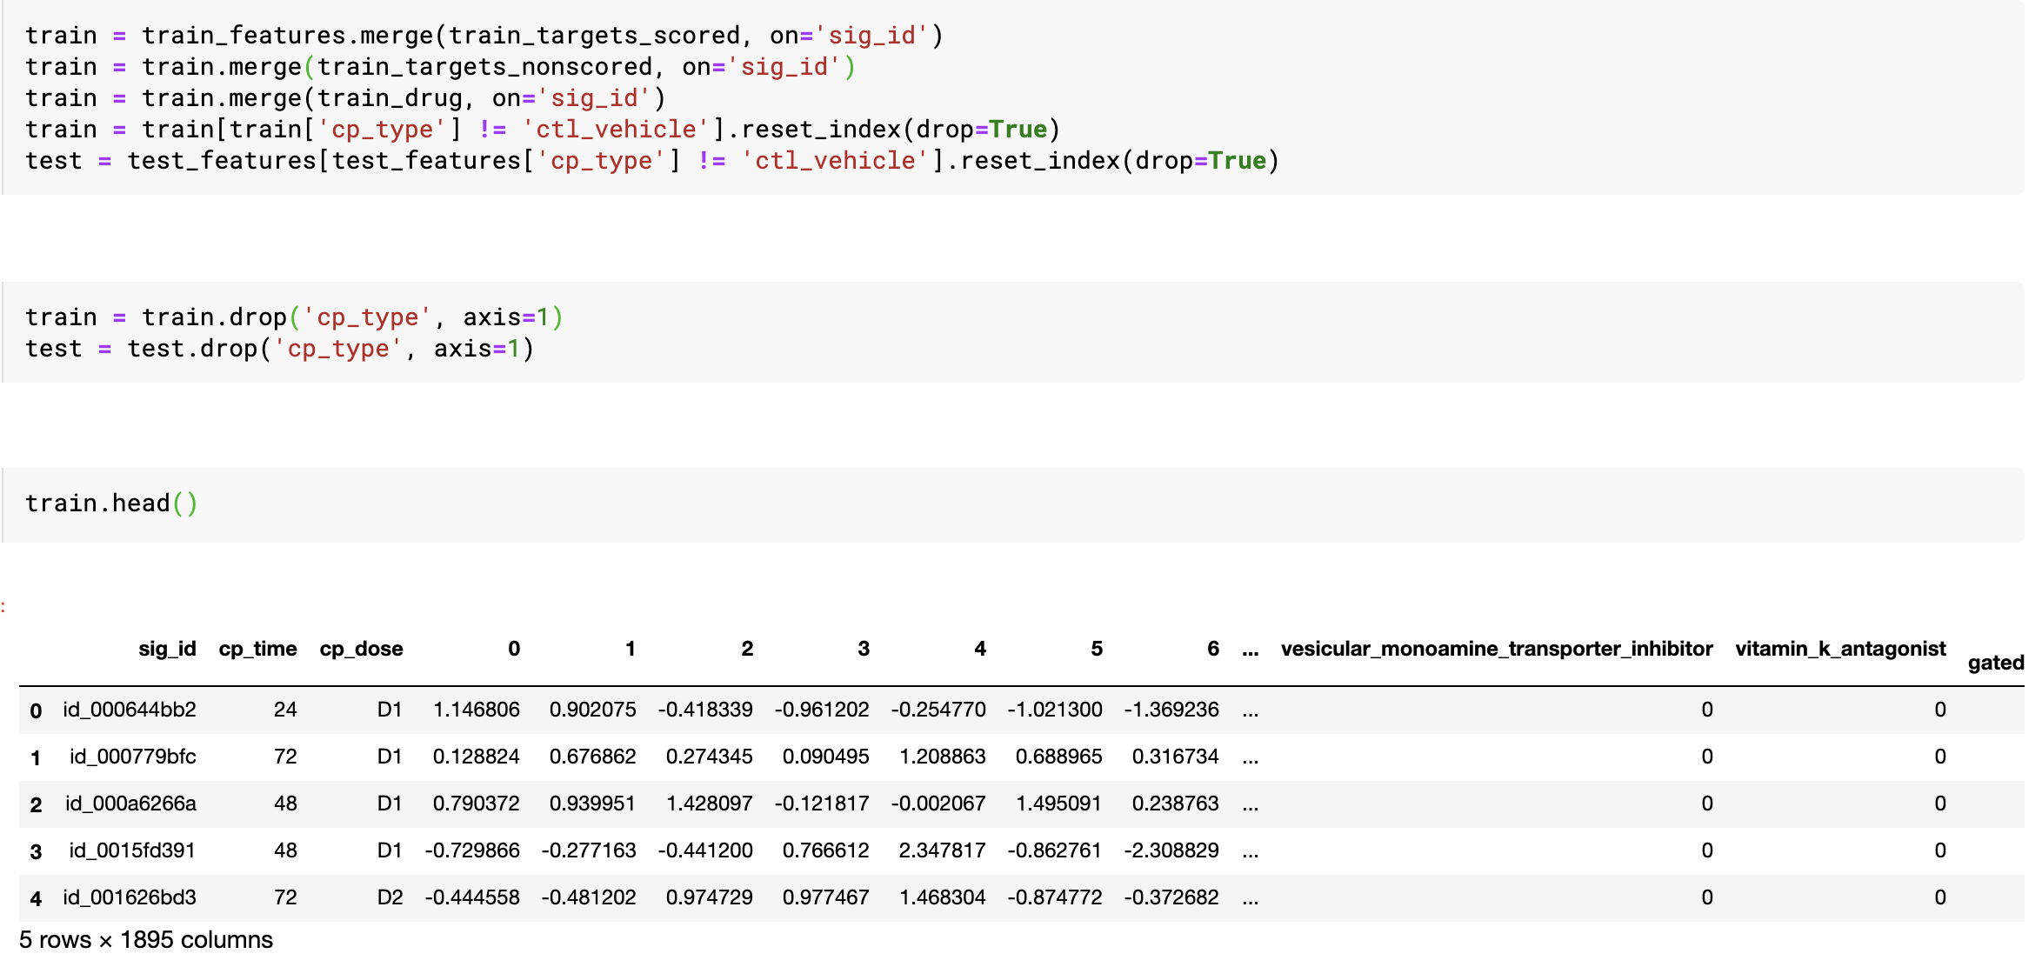
Merge Features

Slide 19
Model Training
General Steps:
Set up batch normalizations
Apply forward and backward propagation
Optimize by label smoothing
Use scheduler to find best learning rate during each epochs
Apply k-folds cross-validation

Slide 20
Batch normalization
Why Batch normalization?
Using batch normalization makes the neural network more stable during training
This may require the use of much larger than normal learning rates, that in turn may further speed up the learning process
And this is why we use scheduler to tune the learning rate later
How does batch normalization work?
Batch normalization normalizes the output of a previous activation layer by subtracting the batch mean and dividing by the batch standard deviation.
Batch normalization lets SGD do the denormalization by changing only these two weights for each activation, instead of losing the stability of the network by changing all the weights.

Slide 21
Forward and backward propagation
These are two most common and important procedures in training neural network model.
Forward propagation refers to the calculation and storage of intermediate variables (including outputs) for a neural network in order from the input layer to the output layer.
While backward propagation is in reverse calculation order and is calculating gradient values based on values from forward propagation.

Slide 22
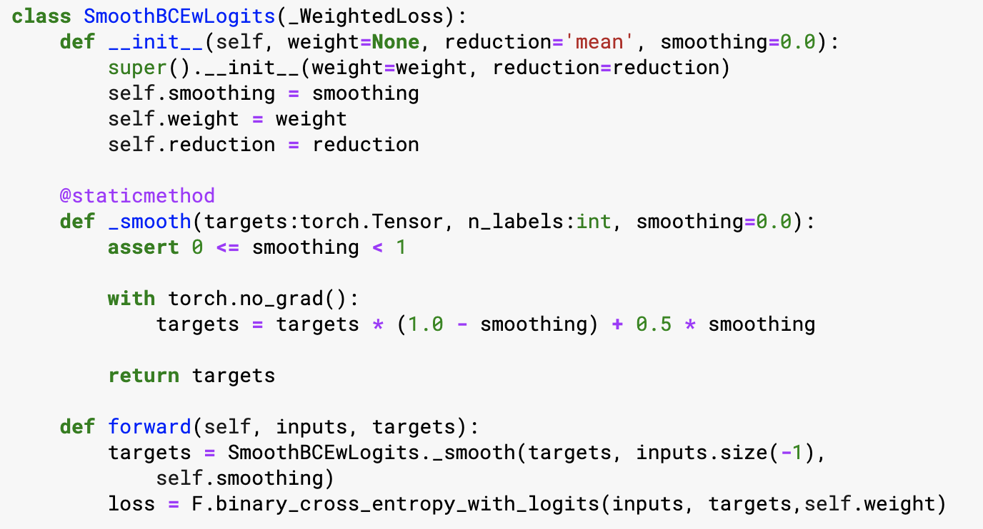
Label Smoothing
When using deep learning models for classification tasks, we usually encounter the following problems: overfitting, and overconfidence. Basically, Label smoothing is a regularization technique that addresses both problems.

Slide 23
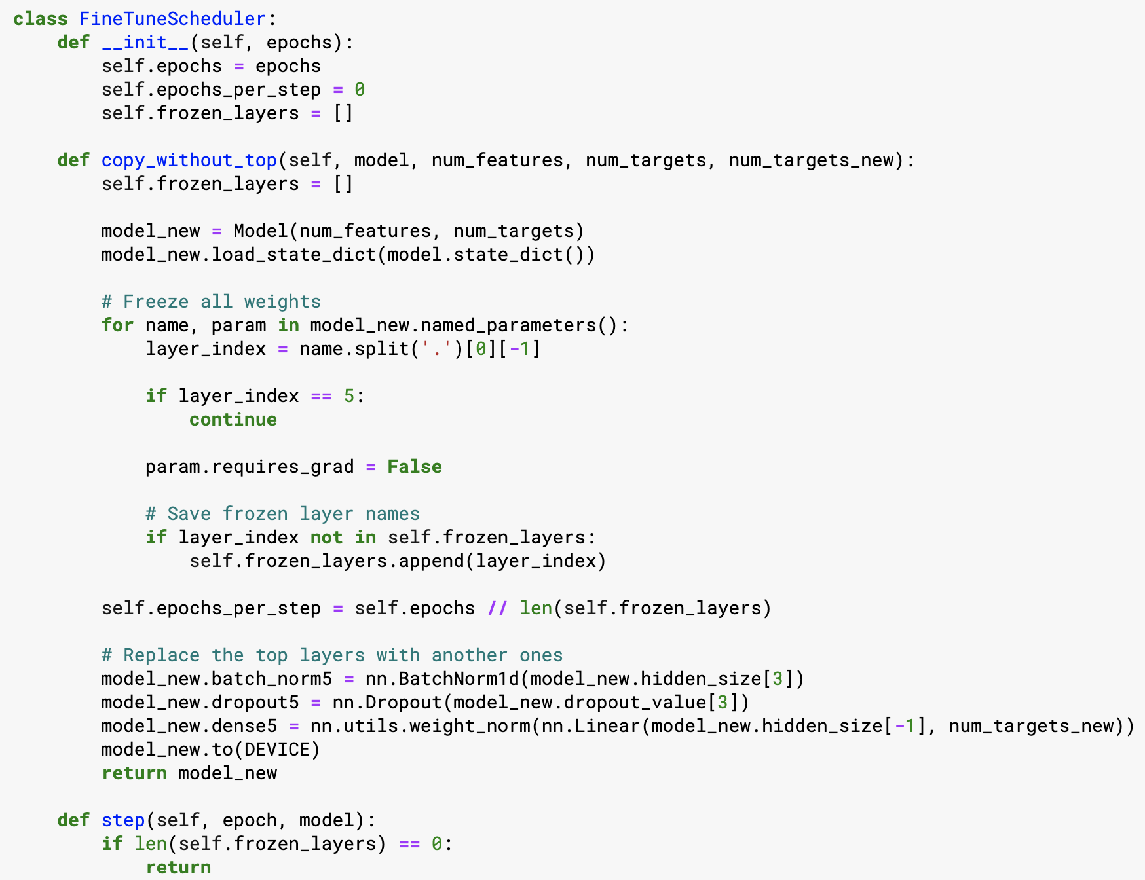
Scheduler
Basically ,it is used to slow down learning rate to potentially get better results.

Slide 24
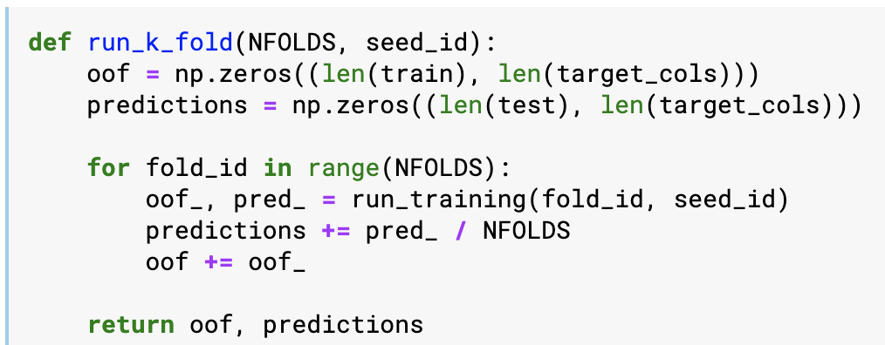
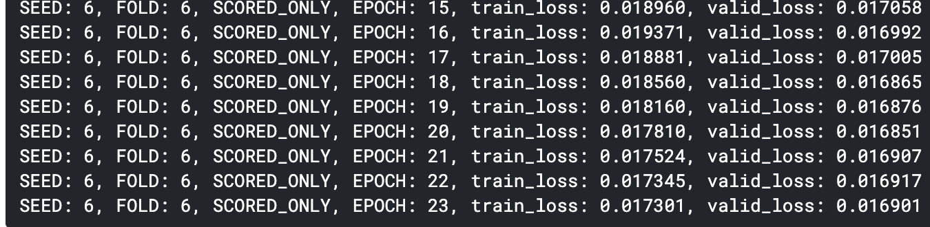
k-folds CV

Slide 25
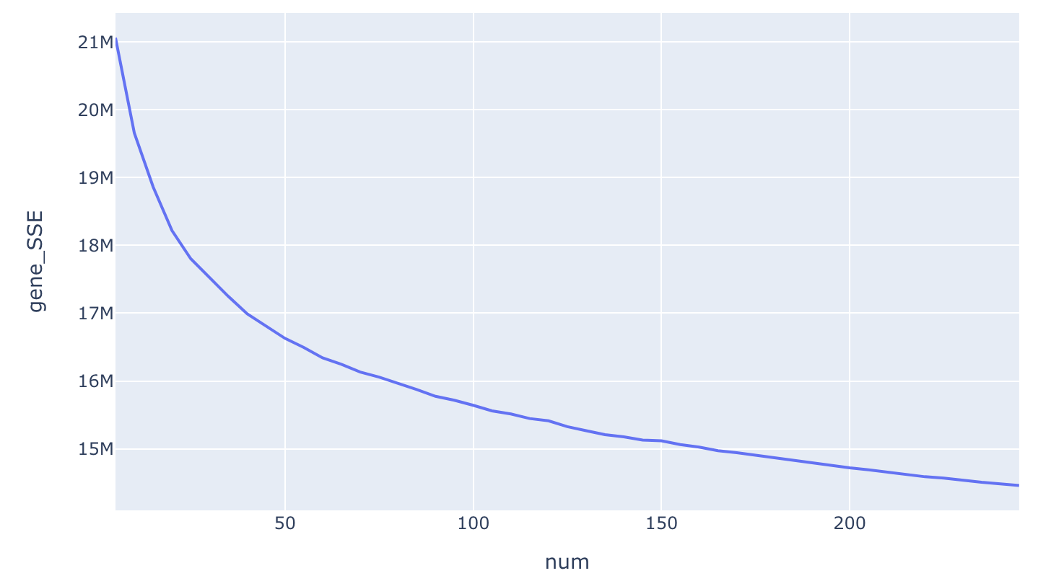
Elbow Method - gene data
From graph on the left, it is not very clear to see which k value to use is the best. So then i try Silhouette Coefficient method.

Slide 26
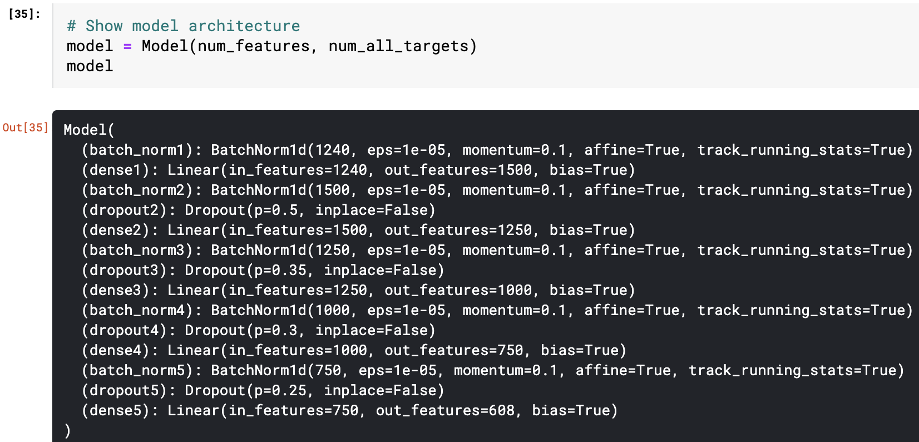
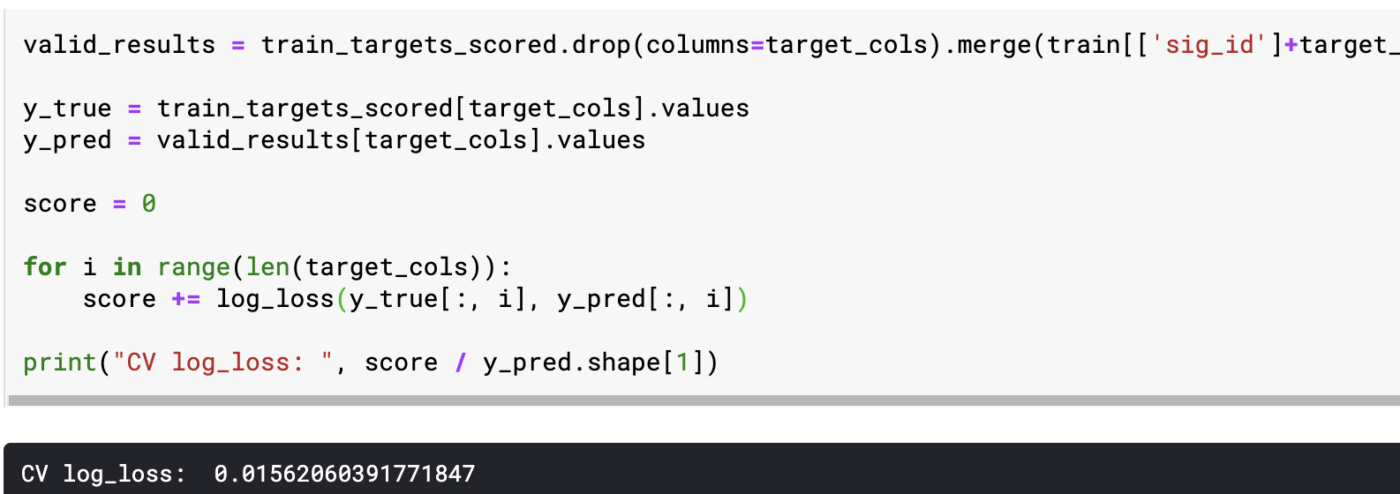
Model and results

Slide 27

Thank you!

